Slide 1
Data Science Meetup:
Week 3
Joshua Bernhard
Galvanize
Data Science Toolkit

Slide 2
Data Scientist Toolkit
Mathematics: Statistics, Machine Learning, Intuition, Domain Experience
Databases: MongoDB, SQL (all things SQL)
Analytics: Python, R, SAS, SPSS, JMP, Minitab
Big Data: Spark, AWS, Pig, Hive, HBase, Flume, Oozie, Kafka, Mahout, Splunk, Storm, Scala
(Data Engineering)
Social Networks: GraphX
Data Visualization: D3, Tableau, R, Python
Natural Language Processing: Python, R
Other: C, C++, Java, Latex, Unix, Bash, Perl, Ruby, JavaScript, HTML, CSS
*I likely left some out…

Slide 3
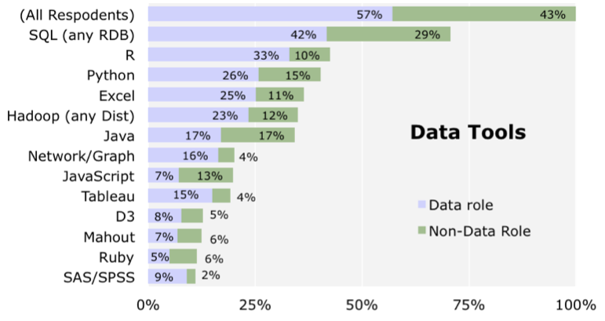
http://blog.revolutionanalytics.com/2014/01/in-data-scientist-survey-r-is-the-most-used-tool-other-than-databases.html

Slide 4
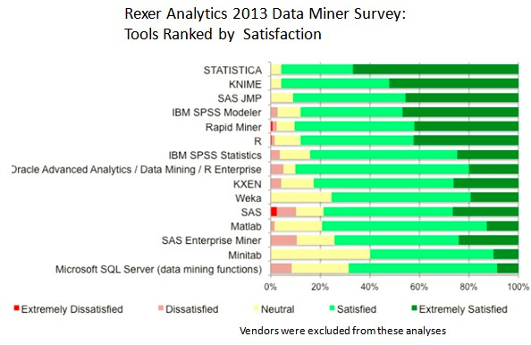

Slide 5
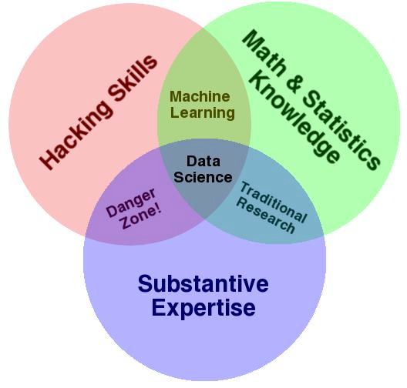
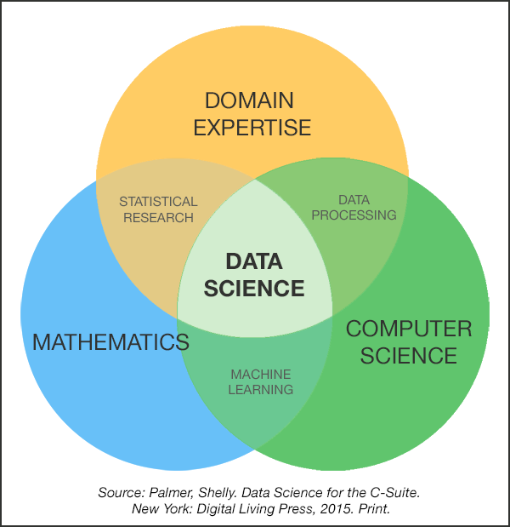
http://www.kdnuggets.com/2014/06/data-science-skills-business-problems.html

Slide 6
Release Dates
Spark - 2015
Hadoop - 2014
Tableau - 2013
Scikit Learn - 2010
R - 1998
Math - Since Forever

Slide 7
How To Get Started
1. Learn How to Code
CodeAcademy, Udacity, DataQuest, w3schools, CodeWars, University of Michigan Coding for Everyone Coursera (This requires you to practice ALOT)
2. Math/Statistics/Machine Learning
Introduction to Statistical Learning, Elements of Statistical Learning (Books), KhanAcademy, Andrew Ng (Coursera)
3. Integration of Code and Math
John Hopkins Data Science Track (Coursera - in R)
4. Big Data
Spark (EdX)
5. Show Your Stuff
Github, Kaggle

